Slide 1

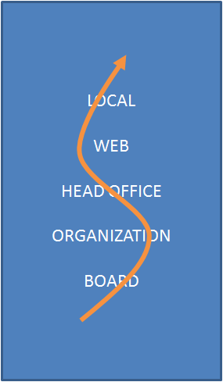
World Sustainability Fund Essence SUM 30B to 1T+ roll out plan
Creating The World We Need
2014-04-04, © & Confidential, Emile van Essen

Slide 2
Profile WSF - World Sustainability Fund
Since December 9, 2011 – Foundation, based on SBF - Stichting Bronning Fonds, May 29, 1992, next level of social responsibility
For Enduring Life, Prosper health & wealth, Education
Realizing “The Future We Need”
U.N. & Major Group related global network
2014-04-04, © & Confidential, Emile van Essen

Slide 3
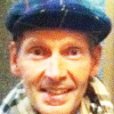
Profile Emile van Essen, P-
Born death 1957-01-01, Alive after prayer, at 33 FEL-Mastery
Visionary, High Sensitive, IQ 137, Mensa 99%, HealerTeacher
Studied: Super Study, Architecture & City ~, Permaculture, Economics, Export, Option Trading, Int. Exec. MBA, Religion (5 big + Theosophy, Anthroposophy, Baha'i, Essene, Scientology) , 300 Complementary Medicine, Quantum Thinking, …
Worked at: KLM, KPN, Ballast Nedam, CAP Gemini, France Telecom, Fortis, …
Business Owner, past: Constructor/Architect, BMW dealer, Int. Business Consultancy
Social Entrepreneur: SBF, GHC, SUM, Presence Foundation
Writer, Plan writer: Bronning Philosophy, Global Integrated Medicine Healthcare, Poverty Eradications, Human Rights
2014-04-04, © & Confidential, Emile van Essen

Slide 4
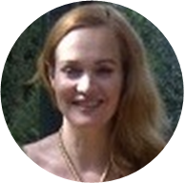
Profile Daniëlle Simons, VP---
Born May 15, 1964
Danielle studied law and philosophy at the University of Leiden, graduated in 1990 and started working for one of the major law offices in the Netherlands, Loeff Claeys Verbeke, later Allen&Overy. She specialised in maritime law, bankruptcy law, corporate recovery, followed postgraduate programs in corporate law and represented an international clientele in court;
In 2006 she initiated a corporate social responsibility project between the Catholic Church and Dutch entrepreneurs, which was the beginning of a turning point in her career, from the mind to the heart;
In 2008, she started investing in waste water technology with her impact investment company Rubicon River B.V., and from then on developed a new approach to waste water treatment with a consortium of specialists, retrieving valuable nutrients from waste water resulting in clean recyclable water, biogas, fertilizer, algae and reduction of CO2;
Mission: (1) to stop the point of no return that will make all ecosystems collapse and (2) to find ways to keep feeding the growing population.
2014-04-04, © & Confidential, Emile van Essen

Slide 5
Essence SUM
Stg. WSF
WSF
WSB
SBF
GHC
ETG
SUM
Essence SUM – Overall Council
Stg. WSF – Financial Management
WSF – World Sustainability Fund HQ + Org.
WSBank – World Sustainability Bank
SBF – Sustainable Health Support
GHC – Sustainable Politics, Law, and Living
ETG – Sustainable Technologies Production
SUM – Sustainable Products Outlets
2014-04-04, © & Confidential, Emile van Essen

Slide 6
Momentum
Durban 200 Countries Sust.plan commitment
250 Emission Clean Development Method’s
Development Loan Scheme 135 Countries
700 Financial Institutions USD 80T for Sust.
Lack on plan level, development & management: WSF fits the shift.
2014-04-04, © & Confidential, Emile van Essen

Slide 7
U.N. SDG’s* 2015-2030 Sept.2014
*SDG’s = Sustainability Development Goals
Including also the Millennium Goals
Near 20 goals, without sufficient targets**
Annual investment 10T to 15T (total 150T to 225T till 2030)
**For “The World We Need” for survival the targets will be not enough, new calculations follows after Sept. 2014 (Needs +/- 40% extra)
2014-04-04, © & Confidential, Emile van Essen

Slide 8
U.N. Post 2015 Agenda
Economic Issues
1. End extreme poverty and eradicate hunger: providing access to basic human needs and services, human rights based approach, and achieving development within planetary boundaries (Linked to All Other Goals) – 15T in 10 year, GHC*.
2. Financing sustainable development, economic transformation, debt, and taxation policy – 5T/year, WSF, WSB, GHC.
3. Sustainable Consumption and Production, corporate responsibility, Infrastructure development and transportation – 1T/year, WSF, WSB, ETG, SUM.
* A Marshall Plan for Poverty Eradication.pdf
2014-04-04, © & Confidential, Emile van Essen

Slide 9
U.N. Post 2015 Agenda
Environmental Issues
4. Secure Ecosystem Services, Biodiversity and Good Management of Natural Resources: resiliency, disaster prevention and response, ecotourism, forests, mountains, desertification, land degradation and drought – 3T/year, WSF, WSB, GHC
5. Oceans, water and sanitation, toxics and wastes – …T, All orgs.
2014-04-04, © & Confidential, Emile van Essen

Slide 10
U.N. Post 2015 Agenda
Social Issues
6. Ensure Effective Learning for All Children and Youth for Life and Livelihood, protect and support cultural heritage – 1T/year, WSB, SBF, GHC
7. Achieve Gender Equality, Social Inclusion, and Human Rights – 1T/year, WSB, GHC
8. Achieve Health and Wellbeing at all Ages – 3T/year, SBF, WSF, WSB, GHC
2014-04-04, © & Confidential, Emile van Essen

Slide 11
U.N. Post 2015 Agenda
Multi-Dimensional Cross Cutting Issues
9. Improve Agriculture Systems and Raise Rural Prosperity
10. Empower Inclusive, Productive and Resilient Cities & Human Settlements – 1T/year, WSF, WSB, GHC.
11. Curb Human-Induced Climate Change and Ensure Clean Sustainable Energy for All – 1T/year, WSF, WSB, GHC.
12. Transform Governance for Sustainable Development: Means of implementation, global partnership, participatory processes, access to information and rule of law – WSF, GHC.
13. Peaceful and non-violent societies: peace building and conflict resolution and capable institutions – WSF, GHC.
2014-04-04, © & Confidential, Emile van Essen

Slide 12
WSF GOALS
1. Gathering of donations in all countries on Earth
2. Moderating “The Future We Need”
3. Moderating the U.N. “The Future We Want” results
4. Reporting “The Gap” between
“The Future We Need” & “The Future We Want”
5. Ranking of “The Most Polluting Habits and Productions”
6. Moderating the ranking of “The Best CDM’s*
7.Moderation Project Proposals for “The Shift”
8. Moderating Projects for realizing “The Shift” ...
*CDMs = Clean Development Methodologies
2014-04-04, © & Confidential, Emile van Essen

Slide 13
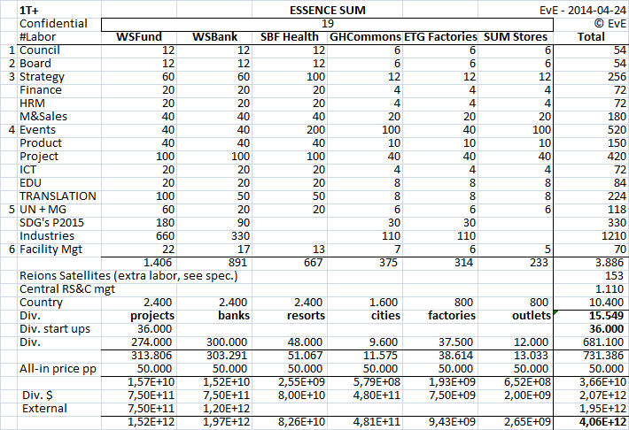
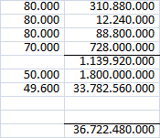
Organization #Labor x 50k
2014-04-04, © & Confidential, Emile van Essen

Slide 14
In short
Central organization 300M/year
Central Region & Country.org 100M/year
Country organizations 700M/year
Country div. reservation 1.800M/year
Together 3B/year + 9B reserve
Projects internal 2T+
Projects external 2T+
Together 4T+ total
2014-04-04, © & Confidential, Emile van Essen

Slide 15
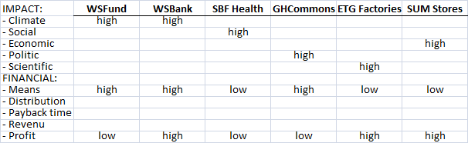
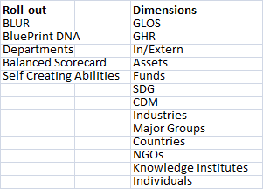

Global Impact, Roll-out & Dimensions
2014-04-04, © & Confidential, Emile van Essen

Slide 16
WSFund WSBank
TWWN* development
In 200 Countries
Over 250 CDM’s**
High Impact on Climate
Financing large projects
Low financial profit
Following WSF targets
In 200 Countries
Over 10 SDG’s***
High Impact on Humanity
Financing The Shift
High financial profit
*TWWN = The World We Need
**CDM’s = Clean Development Methodologies
***SDG’s = Sustainability Development Goals
2014-04-04, © & Confidential, Emile van Essen

Slide 17
C = E x P R = I x U
Climate = Emission times Population
Rescue = Individual action times Utilization
Emission: Limit E by rules, tech & governance
Population: Limit P Resources based
Action: Plan all possible labor
Utilization: Facilitate means for E-reduction
2014-04-04, © & Confidential, Emile van Essen

Slide 18
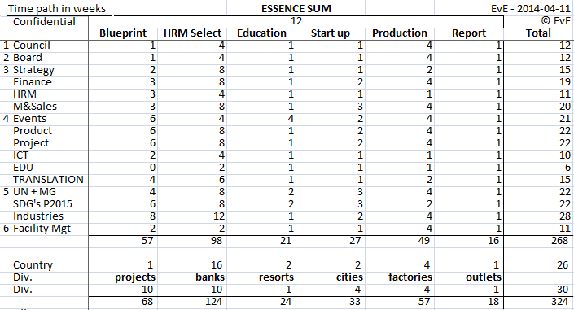
Organization planning
2014-04-04, © & Confidential, Emile van Essen

Slide 19
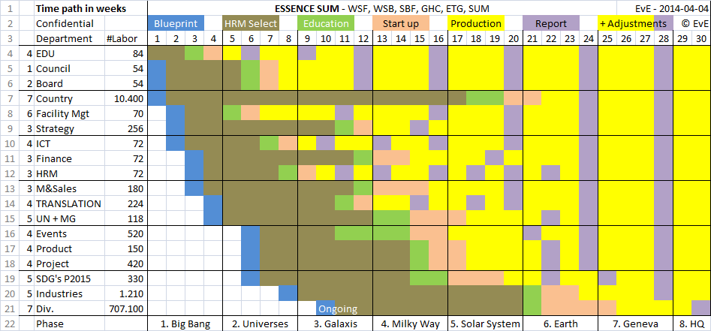
Organization Roll-out
2014-04-04, © & Confidential, Emile van Essen

Slide 20
Creating The World We Need
Creating The Shift
worldsustainabilityfund.nl

Slide 21
WSF
SPIRAL DYNAMICS STRATEGY
VALUE – FINANCE, SUSTAINS, ASSETS
LOCAL
WEB
HEAD OFFICE
ORGANIZATION
BOARD
PRODUCTION – PROJECTS, LOGISTICS, DELIVERY
SALES – MARKETING, OFFERS, CONTRACTS
HRM – KNOWLEDGE + LEARNING GROWTH
STRATEGY – VISION, MISSION, TACTIC
2014-04-04, © & Confidential, Emile van Essen

Slide 22
Location planning
Head Quarter – NL, Utrecht
HQ Visitors Center – NL, Soestdijk ?
Central Region & Country mgt – NL, Den Haag
U.N. CDM Support – DE, Bonn
U.N. HR & Health – CH, Geneva
U.N. GA & Sust. – USA, New York
Region Satellites – Honk Kong, La Paz, OceansP, Kinshasa, Geneva, New York, Yakutsk
Countries – Country dev. Offices, in Capitals
2014-04-04, © & Confidential, Emile van Essen

Slide 23
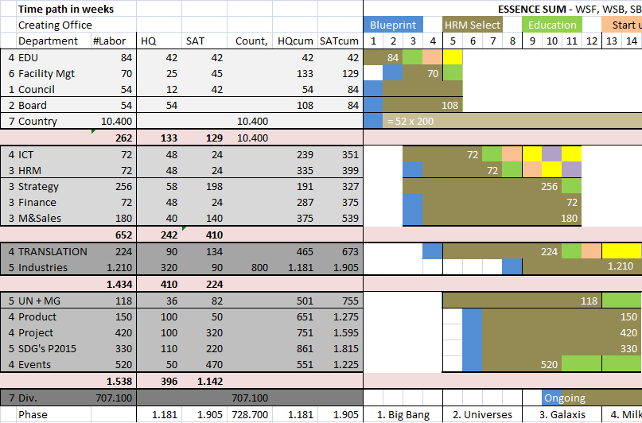
Office labor intake blocks
2014-04-04, © & Confidential, Emile van Essen

Slide 24
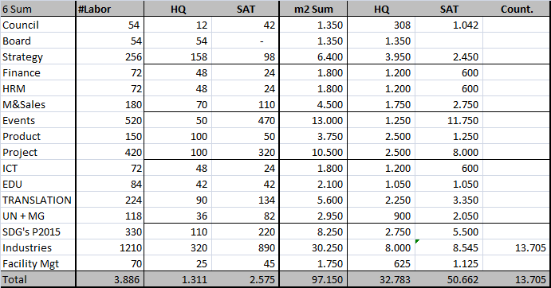
m2 / function
2014-04-04, © & Confidential, Emile van Essen

Slide 25
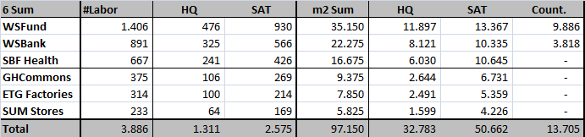
m2 / Head Quarter & Satellites
HQ – NL, Utrecht, 33.000 m2, potential:
Vliegend Hertlaan 15-97, 18.000 m2, 175/m2
Europalaan 40, 16.500 m2, 150/m2
2014-04-04, © & Confidential, Emile van Essen

Slide 26
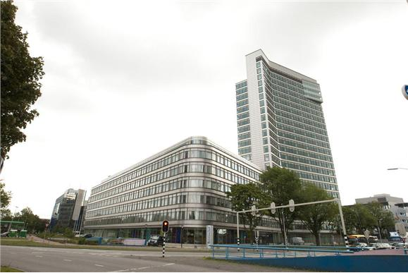
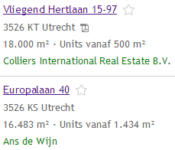
HQ Office
2014-04-04, © & Confidential, Emile van Essen

Slide 27
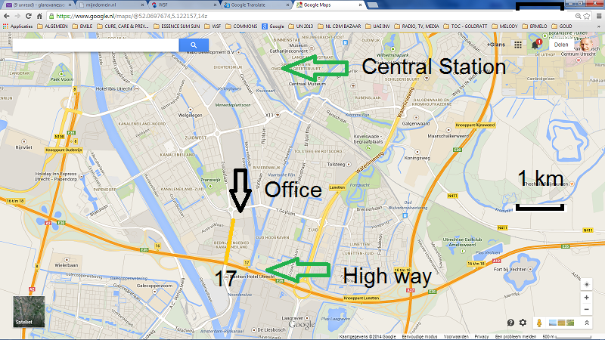
Utrecht
2014-04-04, © & Confidential, Emile van Essen

Slide 28
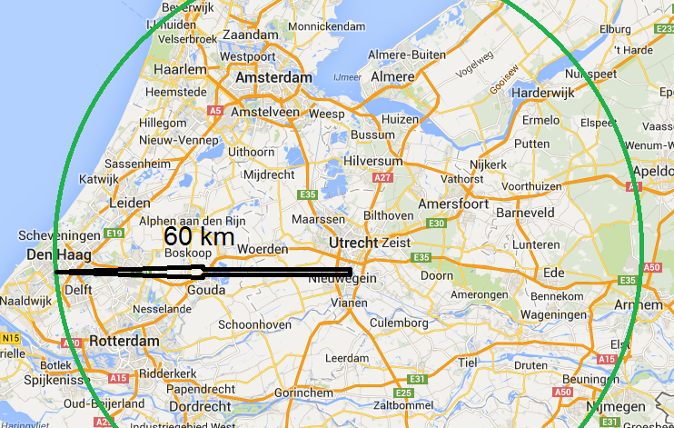
Central in NL, near main cities
2014-04-04, © & Confidential, Emile van Essen

Slide 29
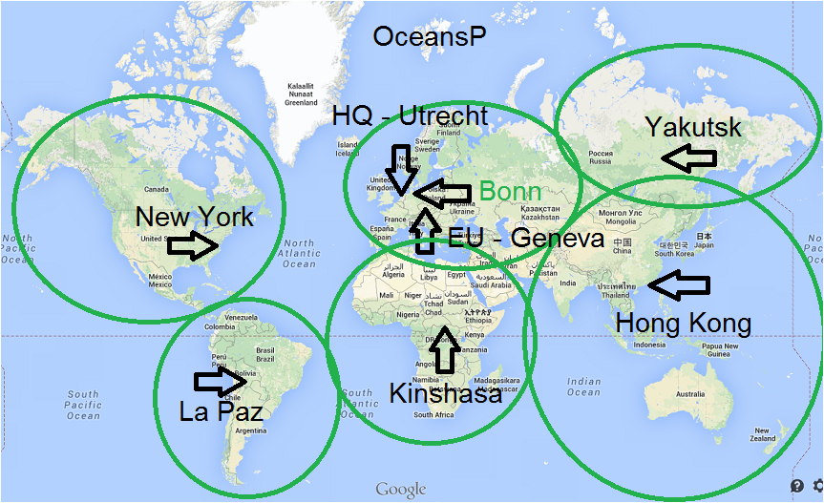
HQ, SATELLITES & COUNTRIES
2014-04-04, © & Confidential, Emile van Essen

Slide 30
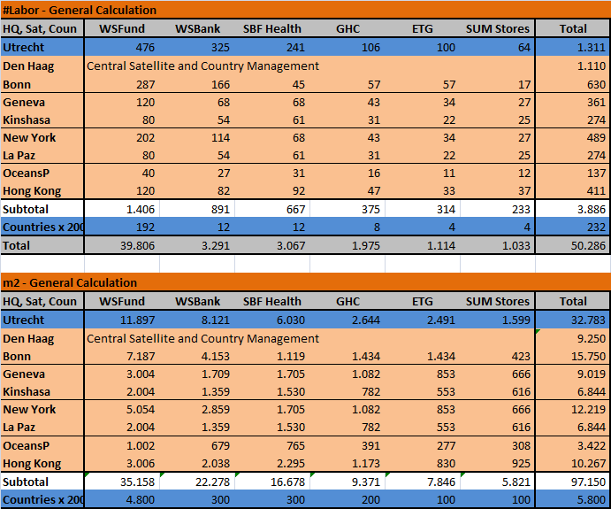
2014-04-04, © & Confidential, Emile van Essen

Slide 31
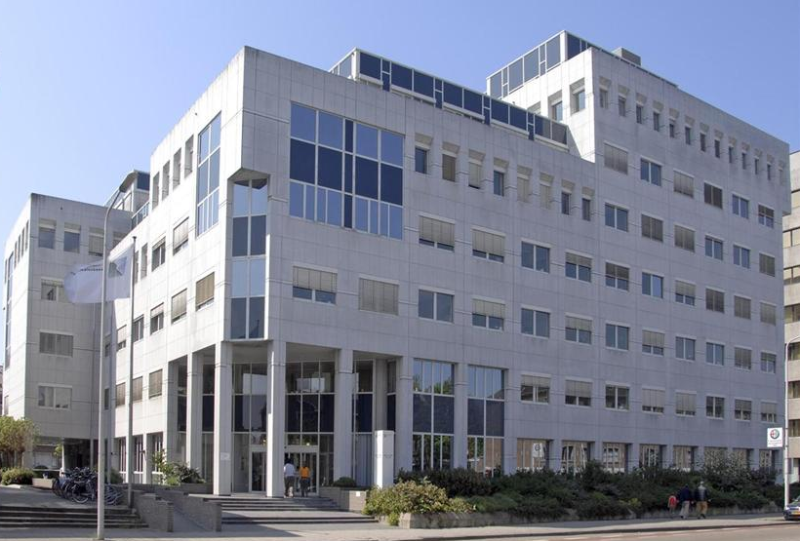

Central Region & Country mgt
2014-04-04, © & Confidential, Emile van Essen

Slide 32
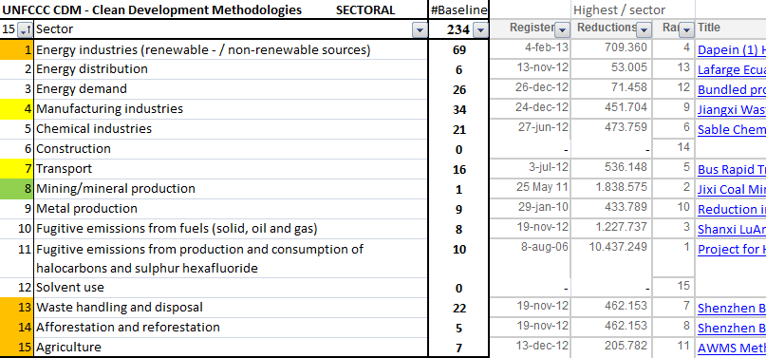
WSF
CDM PRODUCT LINE - 197N
FINANCE
CONSORT
OPTIMAL
CDM
2014-04-04, © & Confidential, Emile van Essen

Slide 33
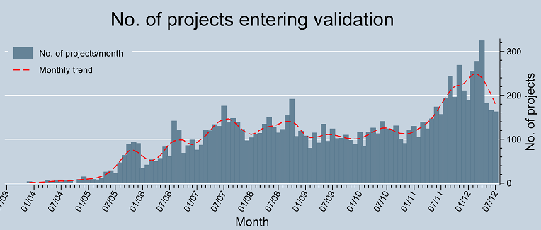
WSF Projects
CDM – Clean Dev. Methodologies
2014-04-04, © & Confidential, Emile van Essen

Slide 34
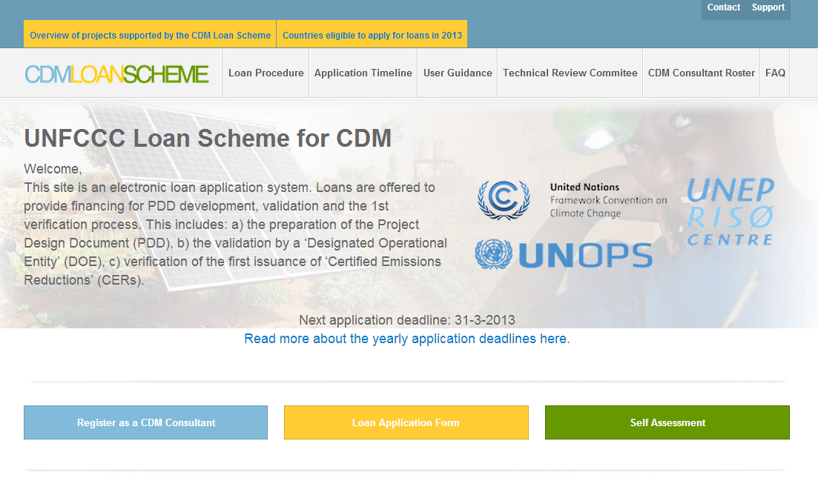
CDM LoanScheme + Bazaar
2014-04-04, © & Confidential, Emile van Essen

Slide 35
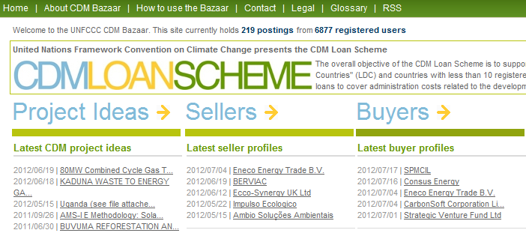
CDM LoanScheme + Bazaar
2014-04-04, © & Confidential, Emile van Essen

Slide 36
WSF
CDM PRODUCT LINE
FINANCE
CONSORT
OPTIMAL
CDM
Intake R&D Finance route € 2.000
UN Loan Scheme request € 20.000
PDD R&D Support € 20.000
PDD Approved Loan + Investment support 2%
PDD not-Approved Loan + Investment support Cost + 3%
2014-04-04, © & Confidential, Emile van Essen

Slide 37
WSF
CDM PRODUCT LINE
The project rocket
BY ERM, SUEZ,
JPM, BGP, …
I
+ 1000K
EB page
Strategy - S
Knowledge & Learning growth - K
Marketing and sales - M
Product logistics - P
Values & finance - V
Loan Scheme - LS
Project design - PDD
Consultant - UNFCCC LS
DOE - UNFCCC PDD Validator
EB - UNFCCC Executive Board
I - In the money, Finance &
Investment for project realization
PDD
MULTI WASTE
150K
DOE ERM, …
INVESTANCIA
SIX
POLYKARPIA
SIP
SFF
NORNED
LS
20K
CONSULTANT GBP, …
M
K
P
V
AGRITERRA
JOHN LIU
ALAINNE
CoR, CDH
2K
S

Slide 38
WSF
CDM PRODUCT LINE
FINANCE
CONSORT
OPTIMAL
CDM
SURE PDD APPROVAL PROJECTS:
Based on actual PDD registrations
135D: Sponsored with € 150.000 development support for 135 developing countries.
197N: Support large scale project Copy/Past with PDD partners and new local consortium partners.
2014-04-04, © & Confidential, Emile van Essen

Slide 39
WSF
SIP PRODUCT LINE
SPONSOR
INVESTMENT
PROGRAM
SIP
In: SIP sponsoring € 20.000
Out: WSF Org dev. € 6.000
1 PDD R&D support € 14.000
In: CDM Loan Scheme € 150.000
Out: SIP Sponsoring retour € 20.000
Out: Project plan dev. € 130.000
In: 1 PDD Financed € 50.000.000
Out: CDM Loan Scheme € 150.000
2% Finance support € 1.000.000
Project development € 48.850.000
2014-04-04, © & Confidential, Emile van Essen

Slide 40
WSF
SIP PRODUCT LINE
SPONSOR
INVESTMENT
PROGRAM
SIP
Project development € 48.850.000
Profit aim 10 % – 50% € 10.000.000
Profit split consortium:
Sponsor € 2.500.000
WSF € 2.500.000
PDD Partner € 2.500.000
New projects € 2.500.000
2014-04-04, © & Confidential, Emile van Essen

Slide 41
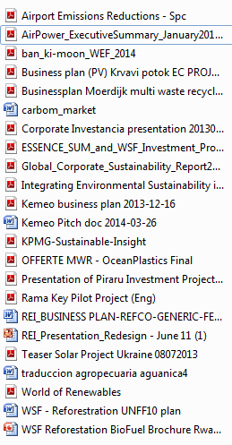

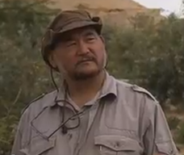
WSF - Projects
150.000.000 km2 Reforestation, inv. 750B
Airport CO₂ savings, inv. 90B, saving 30B/year
Airpower Engines, 0 emission power
Solarfarms Croatia, Ukraine, Rwanda, Mexico
Save drinking water Outlets and Straws
Waste water cleaning
Ocean water Multi Waste Recycling
City & Industrial Multi Waste Recycling
Fish farms, Agriculture, Forestation
2nd Generation AgriBiofuel on non-food area
Wind energy farms on land and at sea
2014-04-04, © & Confidential, Emile van Essen

Slide 42
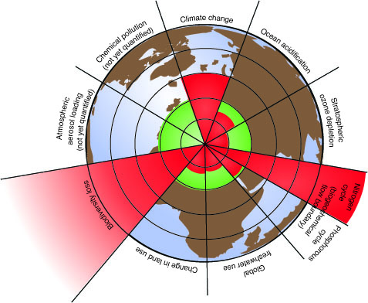
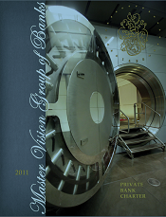
WS Bank - Projects
Banking conform Brundtland definition
Banking recognizing people, planet, profit
Targeting (life plan) savings & sust. investment
2014-04-04, © & Confidential, Emile van Essen

Slide 43
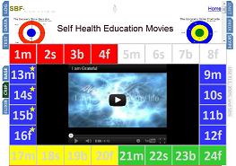
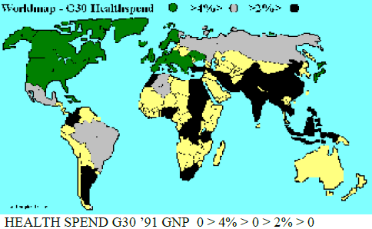
SBF - Projects
42 Integrated Medicine Center in 30 Countries
10.000 beds, Covering 80% of population
Internet popular I.M. education and support
Global I.M. Masters Program at Universities
Buying/Merging with 400 healthcare institutes
Investing 10B+ based on ready business plans
2014-04-04, © & Confidential, Emile van Essen

Slide 44
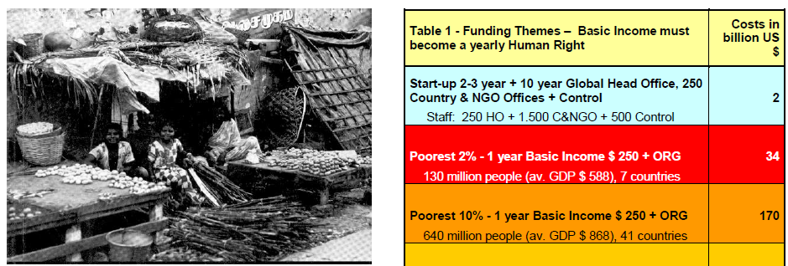
GHC – Projects
Poverty Eradication & Disaster avoidance
UN MG NGO Commons Cluster represent one billion co-operative working people
Commons are the politics for the next 60 year
Emile is director of the Commons IRNetwork
Promoting Global Layers Of Sustainability
Promoting 10 Sustainability Human Rights
Realizing Rural living hoods & City planning
2014-04-04, © & Confidential, Emile van Essen

Slide 45
ETG - Projects
Factories for sust. engines, batteries & energy
Factories for plastic replacing products
Factories for sust. lightning products
Factories for sust. transport solutions
Factories for sust. construction & housing
Factories for sust. agri- & forest cultures
Factories for sust. consumer products
2014-04-04, © & Confidential, Emile van Essen

Slide 46
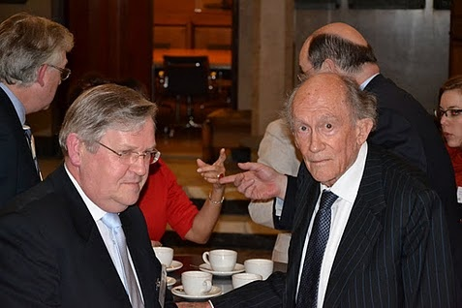
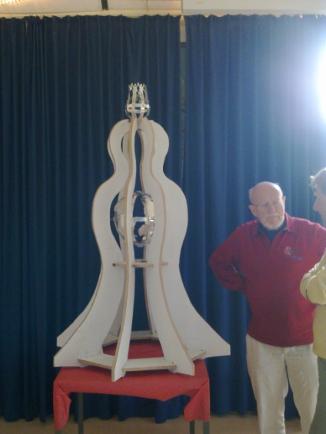

SUM - Outlets
SUM monuments for sust. promotion
Consumer products for sustainable living
Hydrogen apps for fuel and CO₂ savings
Home windmills & solar panels
Webshop and shopping mall outlets
Web apps for sust. Living
Footprint calculation
2014-04-04, © & Confidential, Emile van Essen

Slide 47
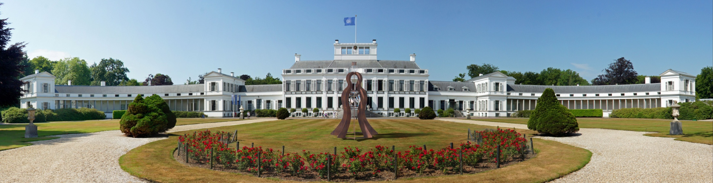
WSF – HQ, Visitors Center ?
Int. Center for Sustainability, Integrate Health, and Leadership development.
2014-04-04, © & Confidential, Emile van Essen

Slide 48
Creating The Shift
Thank You
worldsustainabilityfund.nl

Slide 49
Putting WSF in global perspective
By top: GDP, SWF’s, Banks & NGO’s
By Population stress
By CDM development
2014-04-04, © & Confidential, Emile van Essen

Slide 50
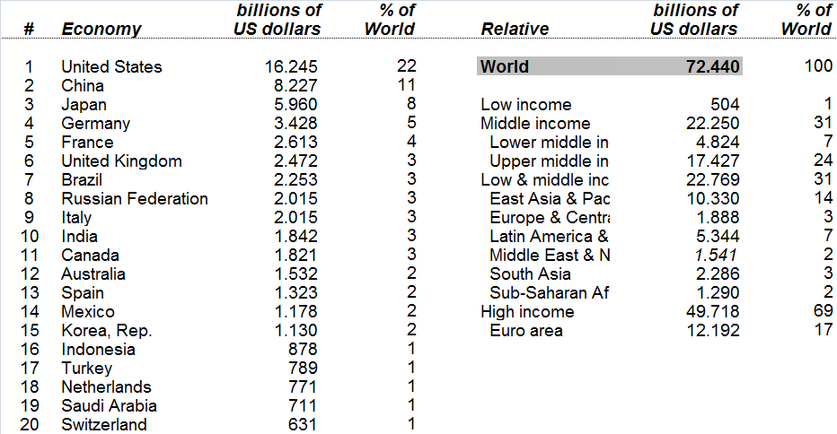
GDP Largest Economies *
*GDP = Gross Domestic Product
2014-04-04, © & Confidential, Emile van Essen

Slide 51
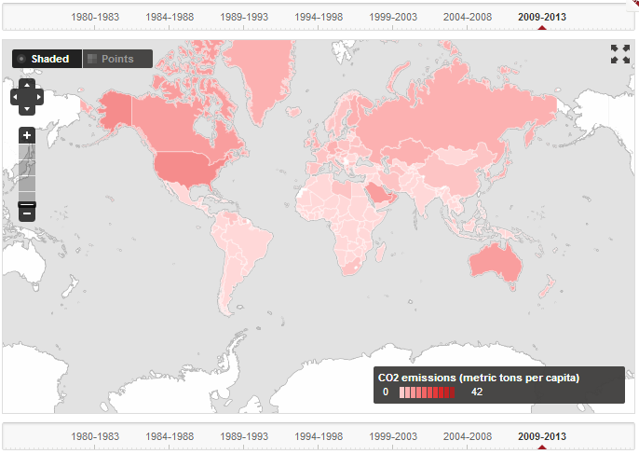
CO2 emissions per capita *
2014-04-04, © & Confidential, Emile van Essen

Slide 52
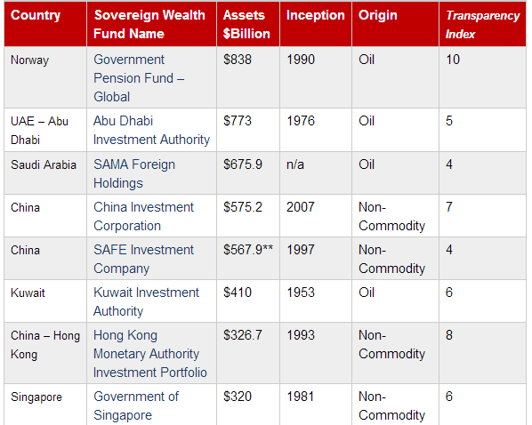
World's Largest SWF’s 2013*
*SWF’s = Sovereign Wealth Funds
2014-04-04, © & Confidential, Emile van Essen

Slide 53
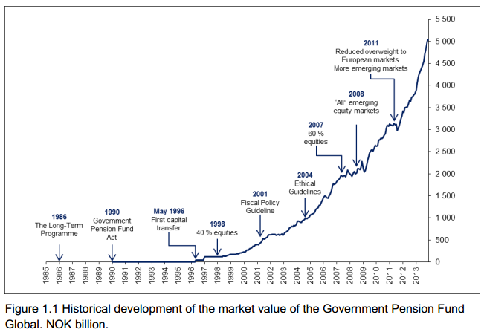
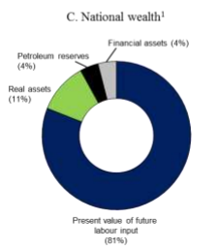
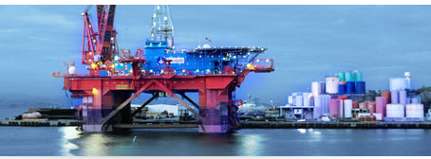
GPFNorway *1, *2
2014-04-04, © & Confidential, Emile van Essen

Slide 54
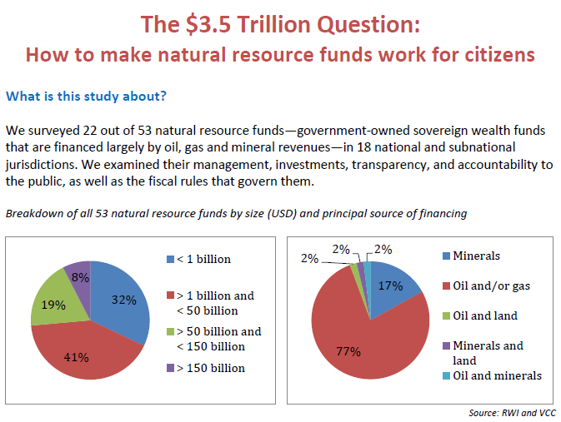
www.revenuewatch.org/nrf
2014-04-04, © & Confidential, Emile van Essen

Slide 55
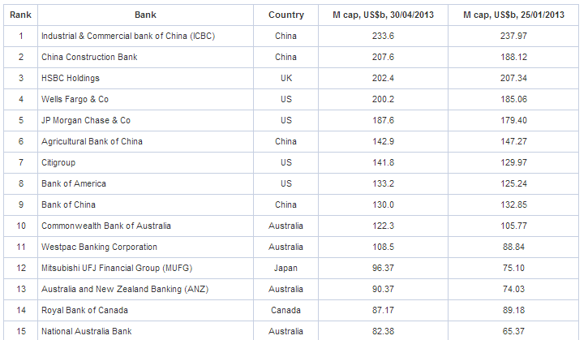
World's Largest Banks 2013*
400.000 Labor
250.000 Labor
2014-04-04, © & Confidential, Emile van Essen

Slide 56
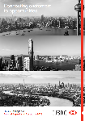
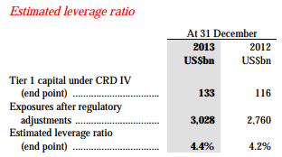
HSBC Annual Report 2013*
54 million customers, 6.300 offices
75 countries, HQ London
250.000 labor, 889 tons CO₂ emission
$ 207 billion market capitalisation
$ 3.028 billion exposures
Our purpose is to be where the growth is, …
2014-04-04, © & Confidential, Emile van Essen

Slide 57
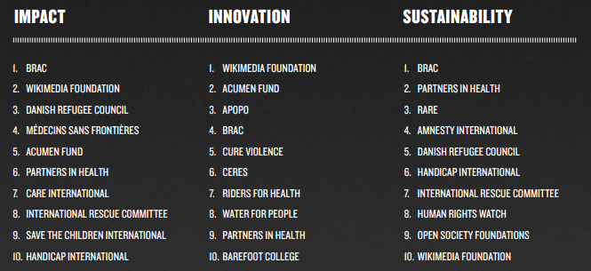
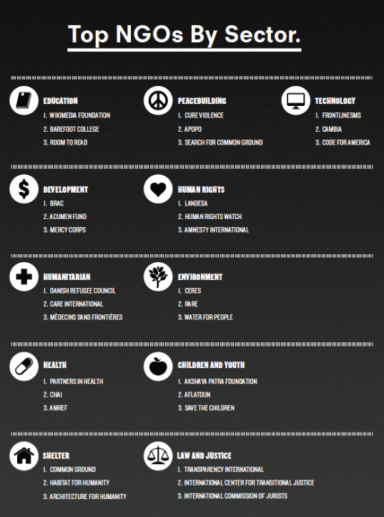
Top NGO’s *1, *2
2014-04-04, © & Confidential, Emile van Essen

Slide 58
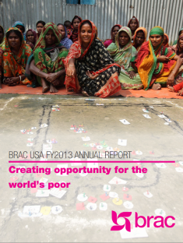
BRAC *
An estimated 135 million people reached
More than 120,000 full-time and contract staff
4.5 million microfinance clients
1.4 million ultra-poor program participants
1.3 million schoolchildren enrolled
312,000 adolescent empowerment club members
114,000 community health workers
11 countries, $ 55 million grants
2014-04-04, © & Confidential, Emile van Essen

Slide 59
Population stress
Citizens expect their governments to lead on sustainability. But from largely disappointing international conferences like Rio II to the failure to pass meaningful climate legislation, governments’ progress has been lackluster. That’s not to say leadership is absent; it just often comes from the bottom up rather than the top down. Action—on climate, species loss, inequity, and other sustainability crises—is being driven by local, people’s, women’s, and grassroots movements around the world, often in opposition to the agendas pursued by governments and big corporations.
2014-04-04, © & Confidential, Emile van Essen

Slide 60
Creating The Shift
Thank You
For complete business plan visit >>>
worldsustainabilityfund.nl

